Slide 1

Machine Learning
ICT-4261
By-
Dr. Jesmin Akhter
Professor
Institute of Information Technology
Jahangirnagar University

Slide 2
Contents
The course will mainly cover the following topics:
A Gentle Introduction to Machine Learning
Important Elements in Machine Learning
Linear Regression
Logistic Regression
Naive Bayes
Support Vector Machines
Decision Trees and Ensemble Learning
Neural Networks and Deep Learning
Unsupervised Learning

Slide 3
Outline
Neural Networks

Slide 4
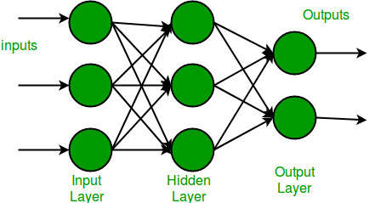
Neural Networks
Neural Networks are inspired by the most complex object in the universe – the human brain.
Let us understand how the brain works first.
The human brain is made up of something called Neurons. A neuron is the most basic computational unit of any neural network, including the brain. Neurons take input, process it, and pass it on to other neurons present in the multiple hidden layers of the network, till the processed output reaches the Output Layer.
In its simplest form, an Artificial Neural Network (ANN) has only three layers – the input layer, the output layer, and a hidden layer.

Slide 5
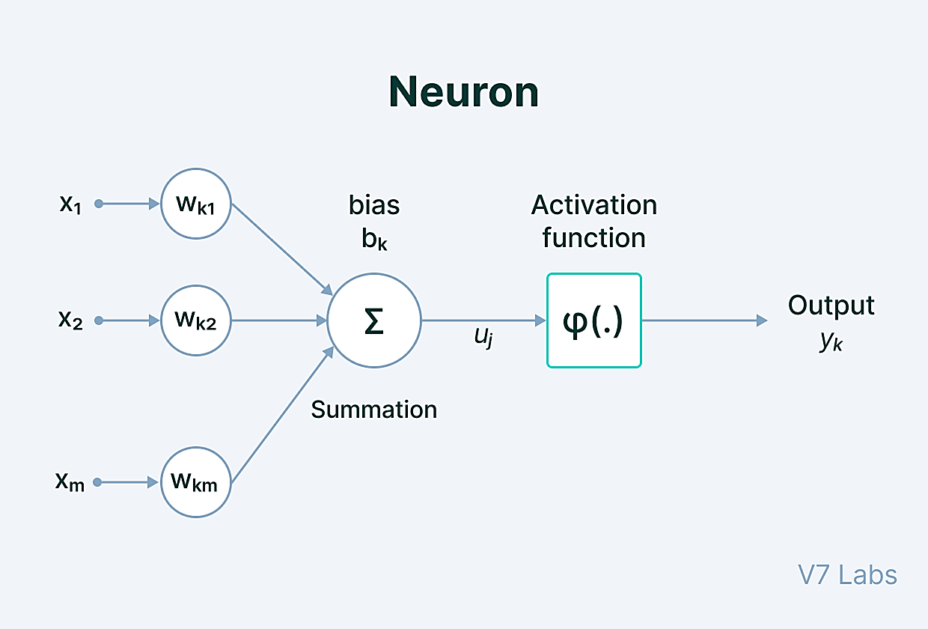
Key Components of the Neural Network Architecture
The Neural Network architecture is made of individual units called neurons that mimic the biological behavior of the brain.
Here are the various components of a neuron.

Slide 6
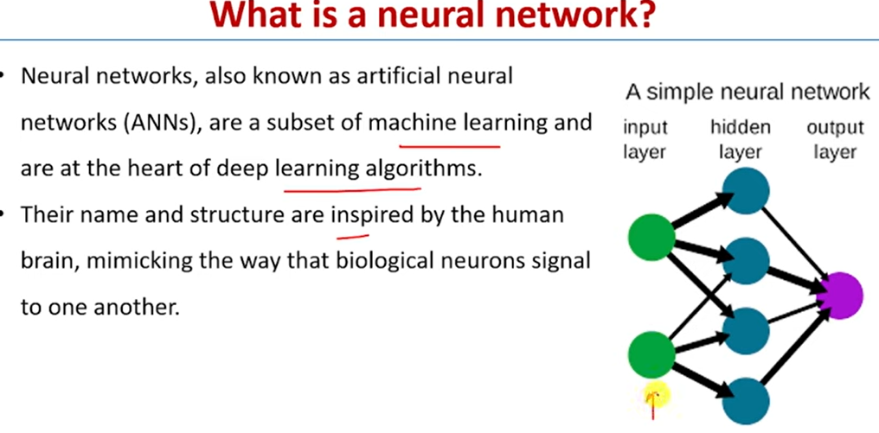

Slide 7
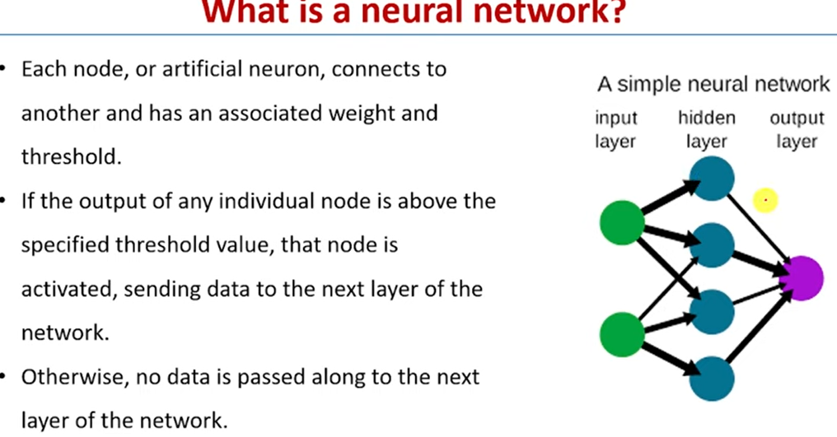

Slide 8
Key Components of the Neural Network Architecture
Input - It is the set of features that are fed into the model for the learning and training process. For example, the input in object detection can be an array of pixel values pertaining to an image.
Weight - Its main function is to give importance to those features that contribute more towards the learning. It does so by introducing scalar multiplication between the input value and the weight matrix. For example, a negative word would impact the decision of the sentiment analysis model more than a pair of neutral words.
Transfer function - The job of the transfer function is to combine multiple inputs into one output value so that the activation function can be applied. It is done by a simple summation of all the inputs to the transfer function.
Activation Function—The role of the activation function is to decide whether or not a specific neuron should be activated. This decision is based on whether or not the neuron’s input will be important to the prediction process
Bias - The role of bias is to shift the value produced by the activation function. Its role is similar to the role of a constant in a linear function. Input - Input is data that is put into the model for learning and training purposes.
Notes:
Input - Input is data that is put into the model for learning and training purposes.
Weight - Weight helps organize the variables by importance and impact of contribution.
Transfer function - Transfer function is when all the inputs are summarized and combined into one output variable.
Activation function - The role of the activation function is to decide whether or not a specific neuron should be activated. This decision is based on whether or not the neuron’s input will be important to the prediction process.
Bias - Bias shifts the value given by the activation function.

Slide 9

Key Components of the Neural Network Architecture
When multiple neurons are stacked together in a row, they constitute a layer, and multiple layers piled next to each other are called a multi-layer neural network.
Multi-layer neural network

Slide 10
Key Components of the Neural Network Architecture
Input Layer
The data that we feed to the model is loaded into the input layer from external sources like a CSV file or a web service. It is the only visible layer in the complete Neural Network architecture that passes the complete information from the outside world without any computation.
Hidden Layers
The hidden layers are what makes deep learning what it is today. They are intermediate layers that do all the computations and extract the features from the data.
There can be multiple interconnected hidden layers that account for searching different hidden features in the data. For example, in image processing, the first hidden layers are responsible for higher-level features like edges, shapes, or boundaries. On the other hand, the later hidden layers perform more complicated tasks like identifying complete objects (a car, a building, a person).

Slide 11
Key Components of the Neural Network Architecture
Output Layer
The output layer takes input from preceding hidden layers and comes to a final prediction based on the model’s learnings. It is the most important layer where we get the final result.
In the case of classification/regression models, the output layer generally has a single node. However, it is completely problem-specific and dependent on the way the model was built.

Slide 12
Why Neural Network Architecture is important
Neural Network Architecture is crucial for several reasons:
Enhanced data processing: Neural networks can handle large volumes of complex data, making them effective in tasks such as image recognition, natural language processing, and sentiment analysis.
Flexibility and adaptability: The architecture can be customized and optimized for different data types and problem domains, allowing businesses to tailor neural networks to their specific needs.
Improved accuracy: Well-designed architectures can improve the accuracy of predictions or classifications by capturing complex patterns and relationships in the data.
Automatic feature extraction: Neural network architectures can automatically learn and extract relevant features from raw data, eliminating the need for manual feature engineering.
Notes:
What is Raw Data?
Raw Data refers to unprocessed information that is collected and stored in its original format. It is the most fundamental form of data, captured directly from various sources, such as sensors, devices, or databases.
Raw Data is typically characterized by its lack of structure, organization, or meaningful interpretation. It may include text files, log files, images, audio recordings, or numeric data.
How Raw Data Works
Raw Data is acquired from different sources and stored as-is without any transformations or modifications. It can be collected manually or automatically through various methods, such as data extraction tools, IoT devices, or data streaming technologies.
Once the Raw Data is collected, it can be stored in databases, data warehouses, or data lakes, where it awaits further processing and analysis.

Slide 13
Neural Network Architecture finds applications in various domains, including:
Image and speech recognition: Neural networks can identify objects, people, and speech patterns in images and audio.
Natural language processing: Neural networks can understand and generate human language, enabling chatbots, machine translation, and sentiment analysis.
Recommendation systems: Neural networks can analyze user behavior and preferences to provide personalized recommendations, as seen in streaming platforms, e-commerce, and social media.
Financial forecasting: Neural networks can predict stock prices, market trends, and financial risks by analyzing historical data.
Healthcare diagnostics: Neural networks can assist in disease diagnosis, medical imaging analysis, and drug discovery.
Notes:
What is Natural Language Processing?
Natural Language Processing (NLP) is a branch of artificial intelligence that deals with the interaction between computers and human language. It involves the development of models and algorithms that enable computers to understand, interpret, and generate human language in a way that is both meaningful and useful.

Slide 14
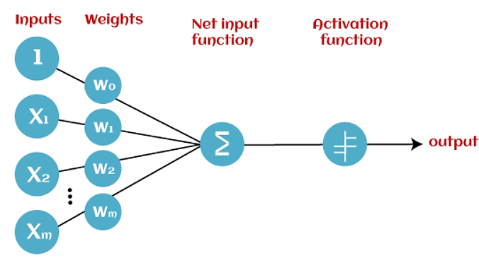
Standard Neural Networks
The Perceptron
Perceptron is the simplest Neural Network architecture. it acts as a single-layer neural network with four main parameters, i.e., input values, weights and Bias, net sum, and an activation function.
It is a type of Neural Network that takes a number of inputs, applies certain mathematical operations on these inputs, and produces an output. It takes a vector of real values inputs, performs a linear combination of each attribute with the corresponding weight assigned to each of them.
The weighted input is summed into a single value and passed through an activation function.
These perceptron units are combined to form a bigger Artificial Neural Network architecture.
Notes:
Perceptron is a linear Machine Learning algorithm used for supervised learning for various binary classifiers. This algorithm enables neurons to learn elements and processes them one by one during preparation.

Slide 15
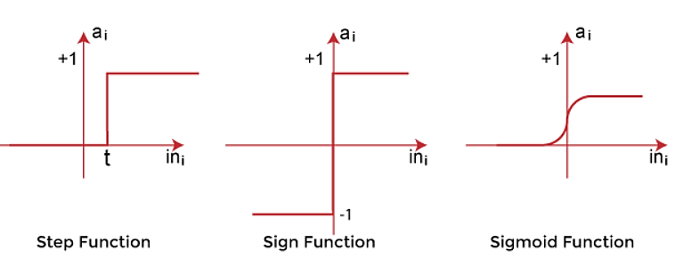
The Perceptron
Input values:
This is the primary component of Perceptron which accepts the initial data into the system for further processing. Each input node contains a real numerical value.
Wight and Bias:
Weight parameter represents the strength of the connection between units. This is another most important parameter of Perceptron components. Weight is directly proportional to the strength of the associated input neuron in deciding the output. Further, Bias can be considered as the line of intercept in a linear equation.
Activation Function:
These are the final and important components that help to determine whether the neuron will fire or not. Activation Function can be considered primarily as a step function.
Types of Activation functions:
Sign function
Step function, and
Sigmoid function
The data scientist uses the activation function to take a subjective decision based on various problem statements and forms the desired outputs. Activation function may differ (e.g., Sign, Step, and Sigmoid) in perceptron models by checking whether the learning process is slow or has vanishing or exploding gradients.

Slide 16
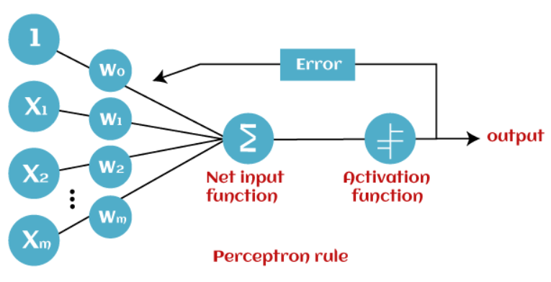
How does Perceptron work?
In Machine Learning, Perceptron is considered as a single-layer neural network that consists of four main parameters named input values (Input nodes), weights and Bias, net sum, and an activation function. The perceptron model begins with the multiplication of all input values and their weights, then adds these values together to create the weighted sum. Then this weighted sum is applied to the activation function 'f' to obtain the desired output. This activation function is also known as the step function and is represented by 'f'.

Slide 17
How does Perceptron work?
This step function or Activation function plays a vital role in ensuring that output is mapped between required values (0,1) or (-1,1). It is important to note that the weight of input is indicative of the strength of a node. Similarly, an input's bias value gives the ability to shift the activation function curve up or down.
Perceptron model works in two important steps as follows:
Step-1
In the first step first, multiply all input values with corresponding weight values and then add them to determine the weighted sum. Mathematically, we can calculate the weighted sum as follows:
∑wi*xi = x1*w1 + x2*w2 +…wn*xn
Add a special term called bias 'b' to this weighted sum to improve the model's performance.
∑wi*xi + b
Step-2
In the second step, an activation function is applied with the above-mentioned weighted sum, which gives us output either in binary form or a continuous value as follows:
Y = f(∑wi*xi + b)

Slide 18
The Perceptron
Based on the layers, Perceptron models are divided into two types. These are as follows:
Single-layer Perceptron Model
Multi-layer Perceptron model
Single Layer Perceptron Model:
This is one of the easiest Artificial neural networks (ANN) types. A single-layered perceptron model consists feed-forward network and also includes a threshold transfer function inside the model. The main objective of the single-layer perceptron model is to analyze the linearly separable objects with binary outcomes.
In a single layer perceptron model, its algorithms do not contain recorded data, so it begins with inconstantly allocated input for weight parameters. Further, it sums up all inputs (weight). After adding all inputs, if the total sum of all inputs is more than a pre-determined value, the model gets activated and shows the output value as +1.
If the outcome is same as pre-determined or threshold value, then the performance of this model is stated as satisfied, and weight demand does not change. However, this model consists of a few discrepancies triggered when multiple weight inputs values are fed into the model. Hence, to find desired output and minimize errors, some changes should be necessary for the weights input.
"Single-layer perceptron can learn only linearly separable patterns."

Slide 19
The Perceptron
Multi-Layered Perceptron Model:
Like a single-layer perceptron model, a multi-layer perceptron model also has the same model structure but has a greater number of hidden layers.
The multi-layer perceptron model is also known as the Backpropagation algorithm, which executes in two stages as follows:
Forward Stage: Activation functions start from the input layer in the forward stage and terminate on the output layer.
Backward Stage: In the backward stage, weight and bias values are modified as per the model's requirement. In this stage, the error between actual output and demanded originated backward on the output layer and ended on the input layer.
Hence, a multi-layered perceptron model has considered as multiple artificial neural networks having various layers in which activation function does not remain linear, similar to a single layer perceptron model. Instead of linear, activation function can be executed as sigmoid, TanH, ReLU, etc., for deployment.
A multi-layer perceptron model has greater processing power and can process linear and non-linear patterns. Further, it can also implement logic gates such as AND, OR, XOR, NAND, NOT, XNOR, NOR.
Notes:
A feedforward neural network is a type of artificial neural network where information flows in one direction, from input to output, without any cycles or feedback loops. Backpropagation is a training algorithm used to adjust the weights and biases of a neural network, including feedforward networks, by propagating the error signal backward from the output layer to the input layer.

Slide 20
Advantages of Multi-Layer Perceptron:
A multi-layered perceptron model can be used to solve complex non-linear problems.
It works well with both small and large input data.
It helps us to obtain quick predictions after the training.
It helps to obtain the same accuracy ratio with large as well as small data.
Disadvantages of Multi-Layer Perceptron:
In Multi-layer perceptron, computations are difficult and time-consuming.
In multi-layer Perceptron, it is difficult to predict how much the dependent variable affects each independent variable.
The model functioning depends on the quality of the training.

Slide 21
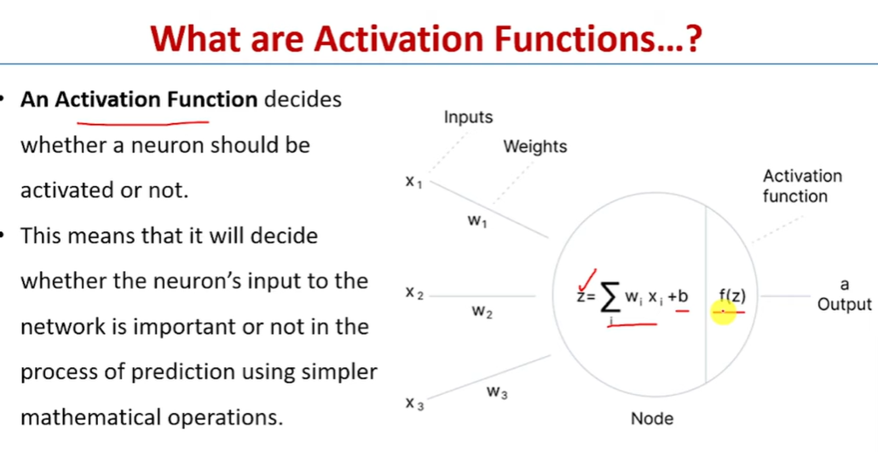

Slide 22
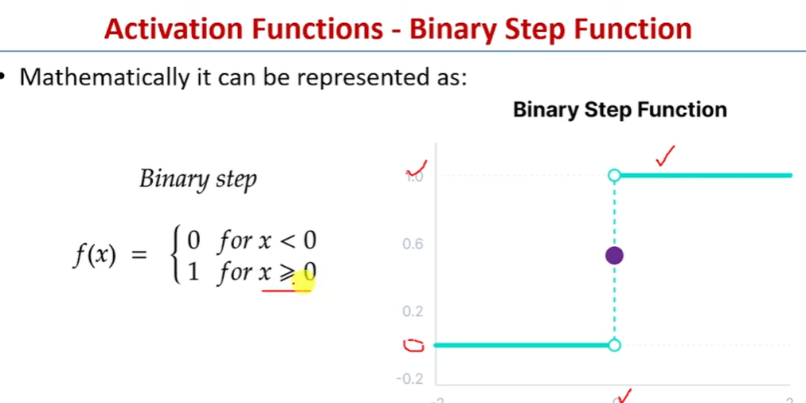

Slide 23
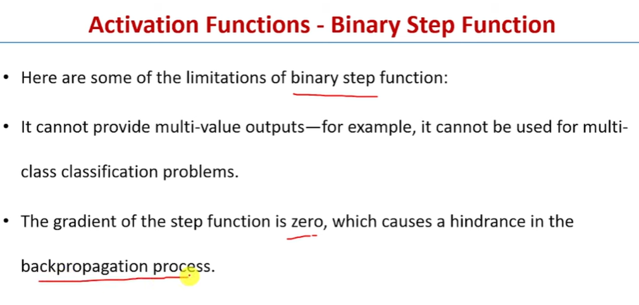

Slide 24
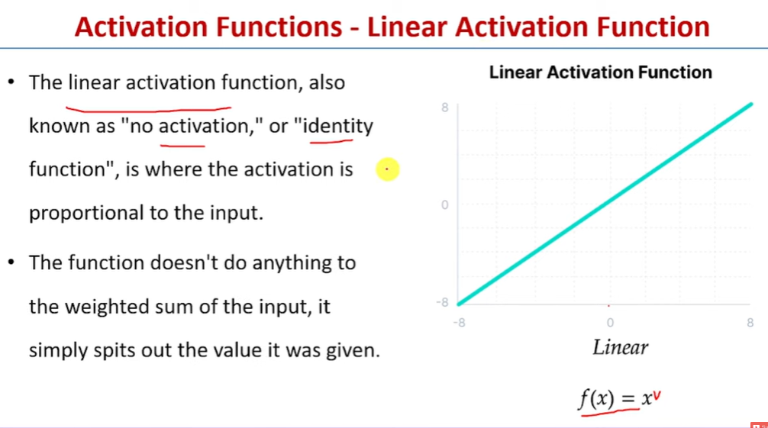

Slide 25
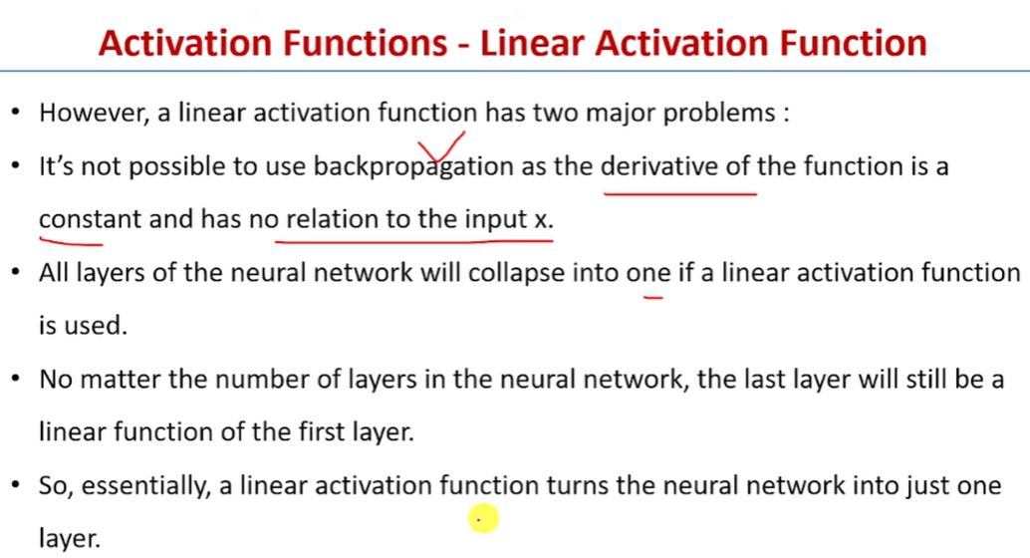

Slide 26
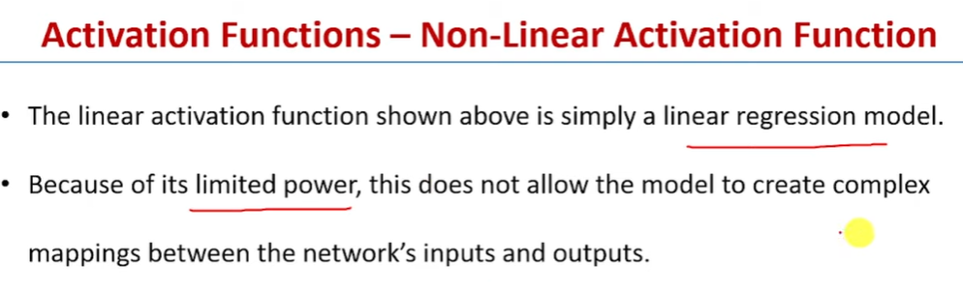

Slide 27
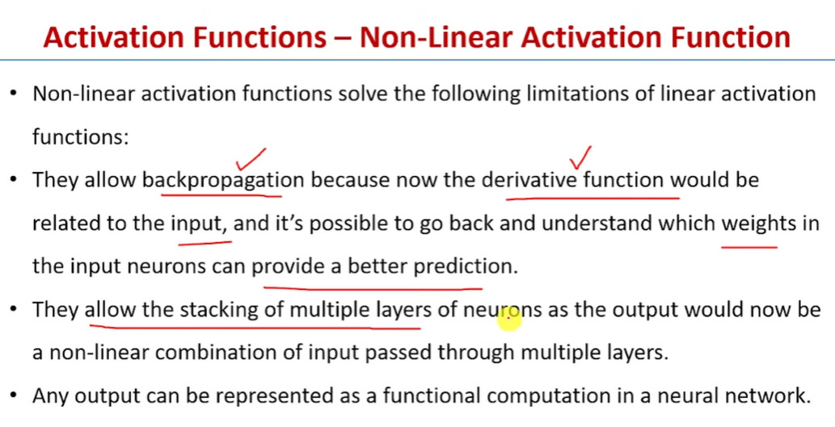

Slide 28
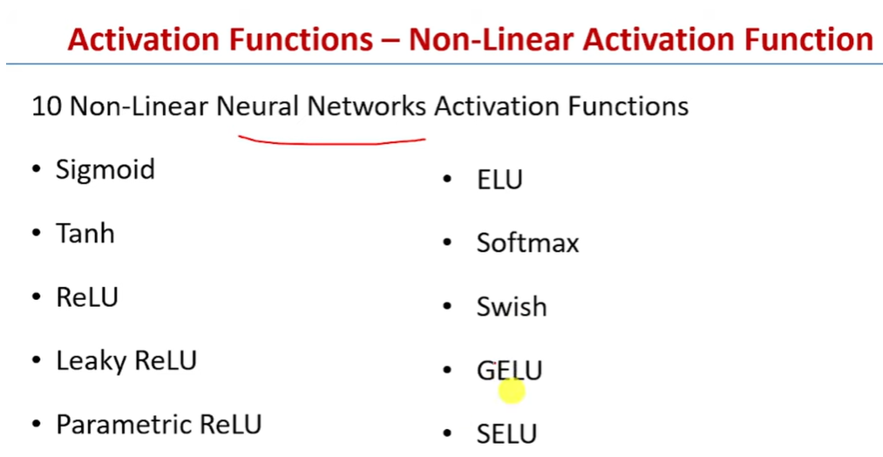

Slide 29
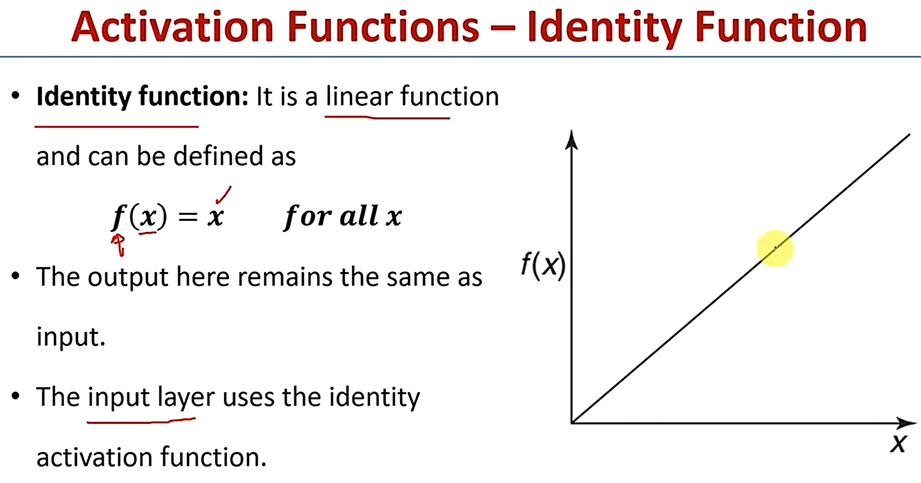

Slide 30
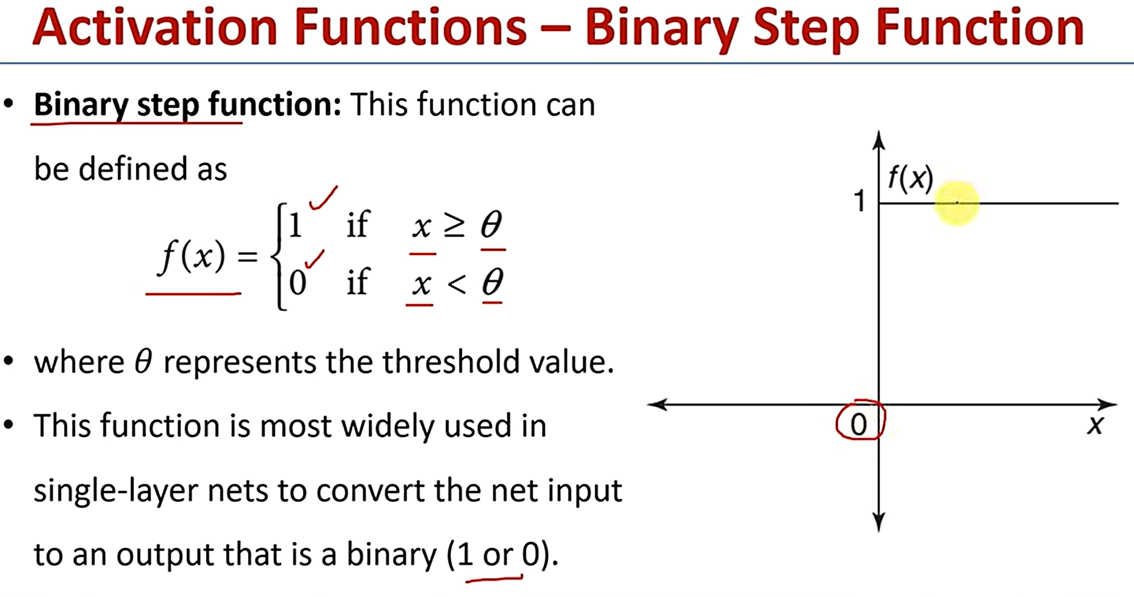

Slide 31
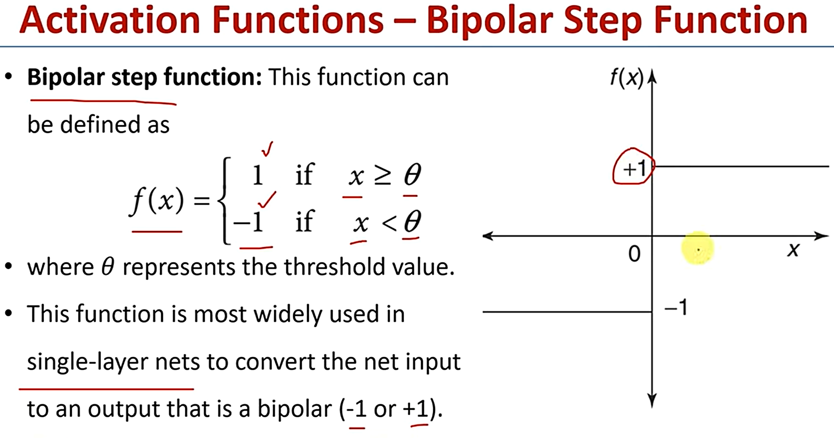

Slide 32
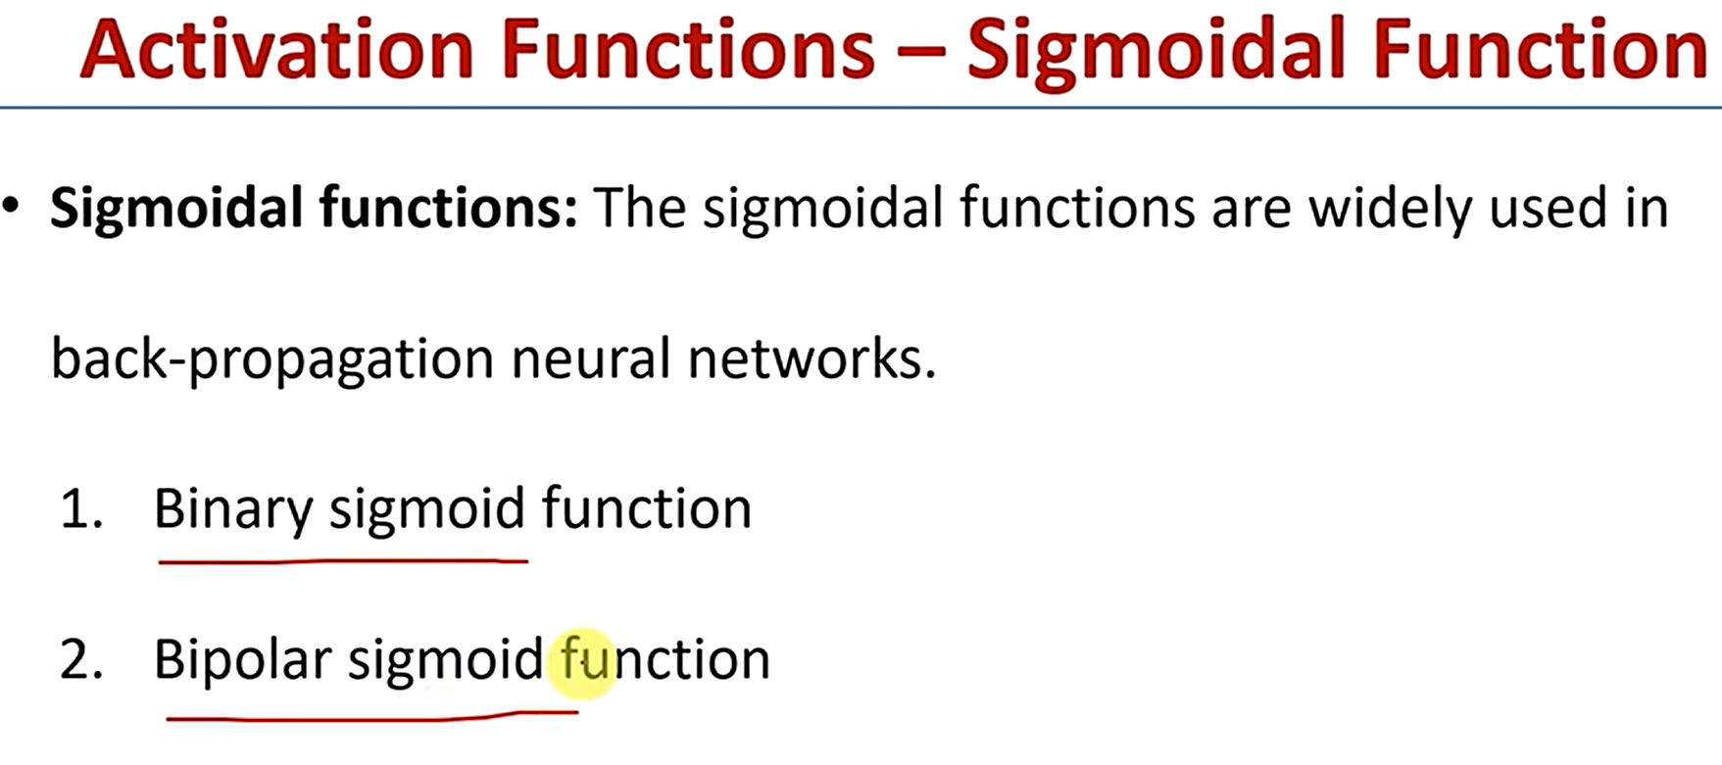

Slide 33
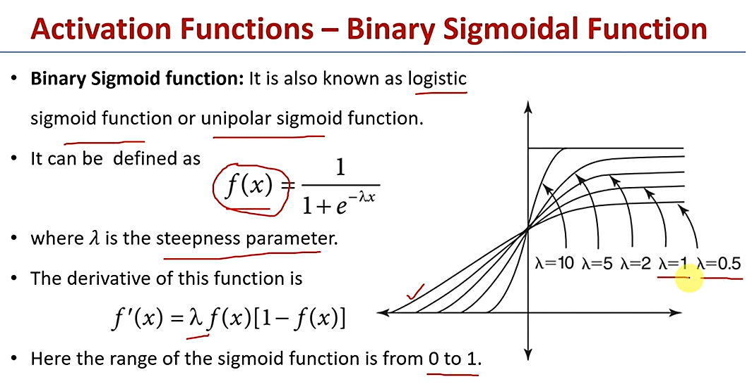

Slide 34
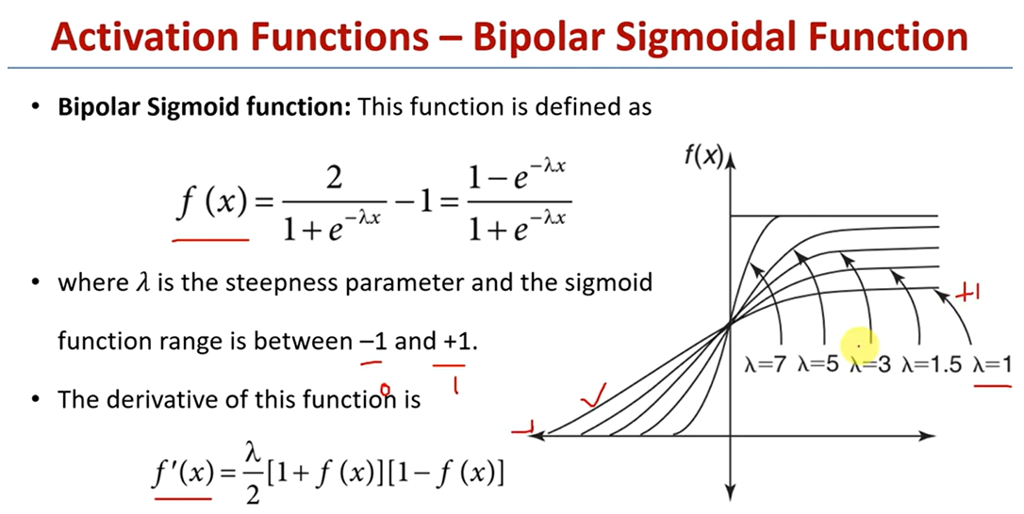

Slide 35
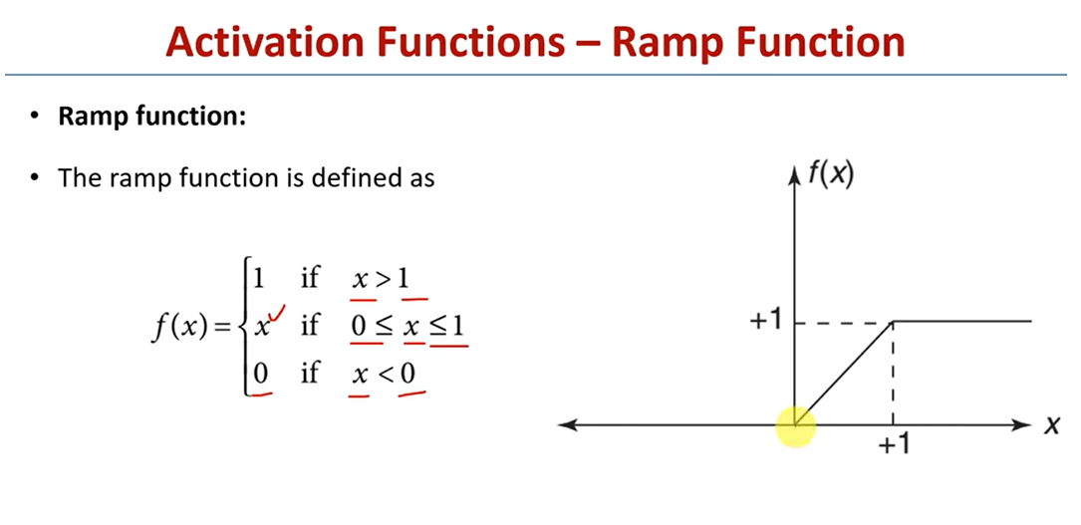

Slide 36
What is the Perceptron Rule?
The Perceptron Rule is an algorithm used to train a perceptron, the simplest type of artificial neural network, designed for binary classification tasks. It adjusts the weights assigned to the input features based on the errors made in predictions. This allows the perceptron to improve its ability to distinguish between two classes over time, learning the optimal decision boundary between them.
Perceptron Rule Explained:
1. Initialization:
Weights and Bias: Start by initializing the weights (parameters that determine the importance of each input feature) and the bias (a threshold value) to small random values or zeros.
Learning Rate (η): Choose a learning rate that controls the magnitude of weight updates. A common choice is a small positive value like 0.01.

Slide 37
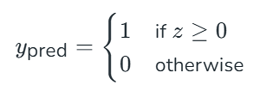
2. Training Process:
Input Presentation: Present each training example to the perceptron one at a time.
Weighted Sum Calculation: For each input vector (x), calculate the weighted sum:
z=w⋅x+b
where (w) is the weight vector, (x) is the input vector, and (b) is the bias.
Activation Function: Apply the activation function (typically a step function) to determine the predicted output y_{pred}:
Error Calculation: Compute the error by comparing the predicted output y_{pred} with the actual target y :
Error=y−ypred

Slide 38
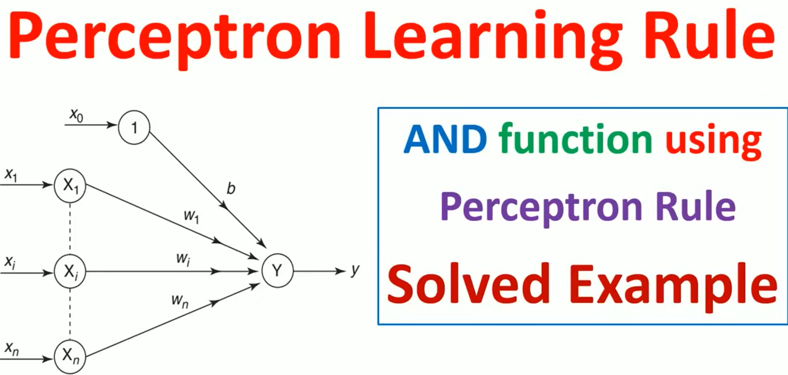

Slide 39
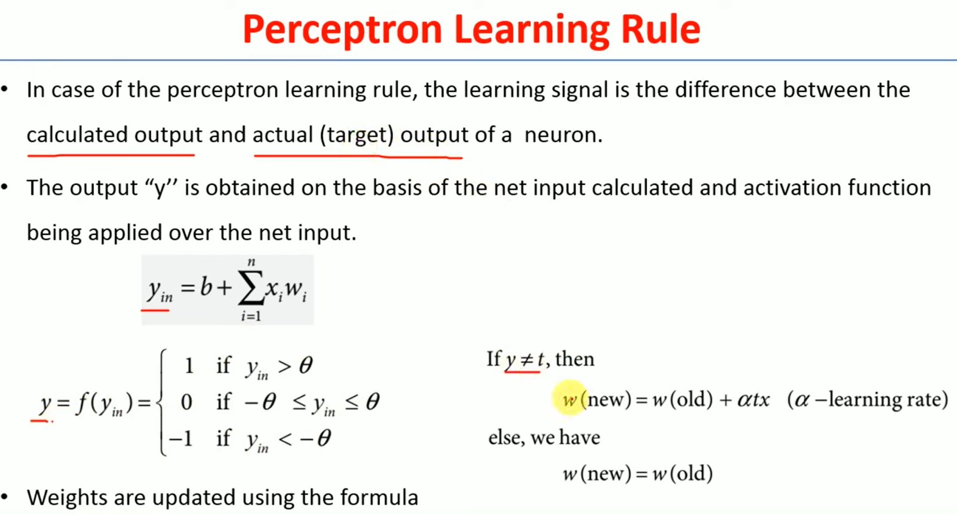

Slide 40
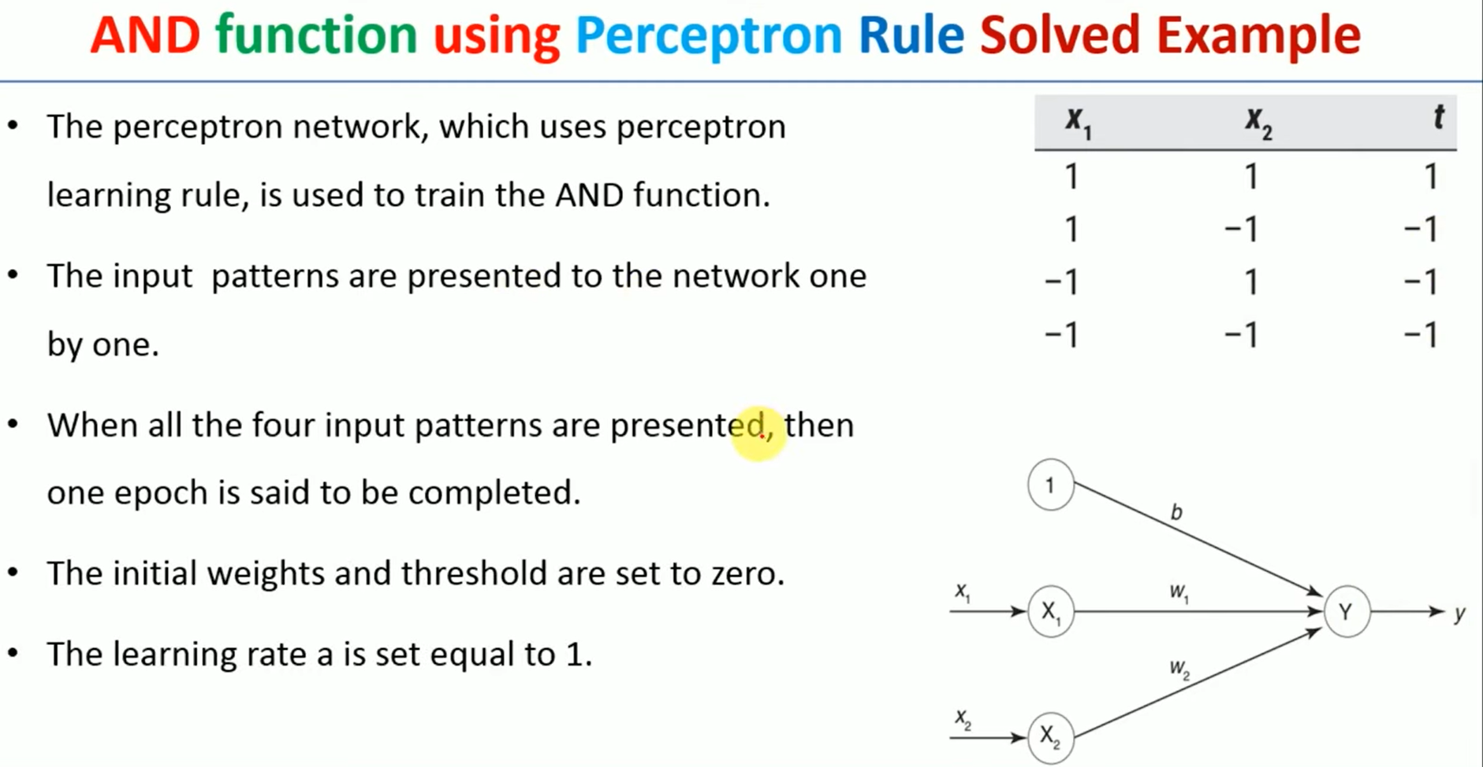

Slide 41
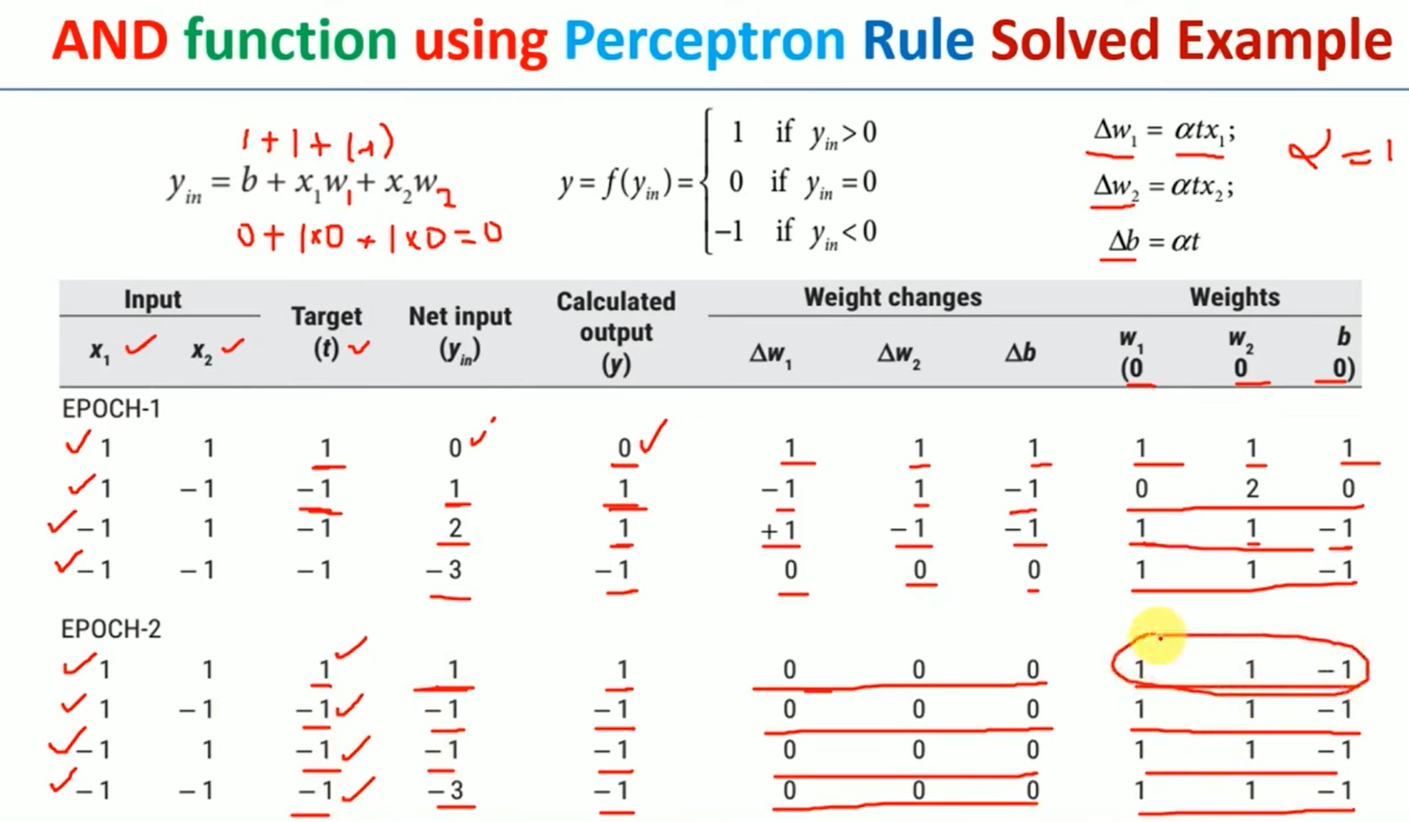

Slide 42
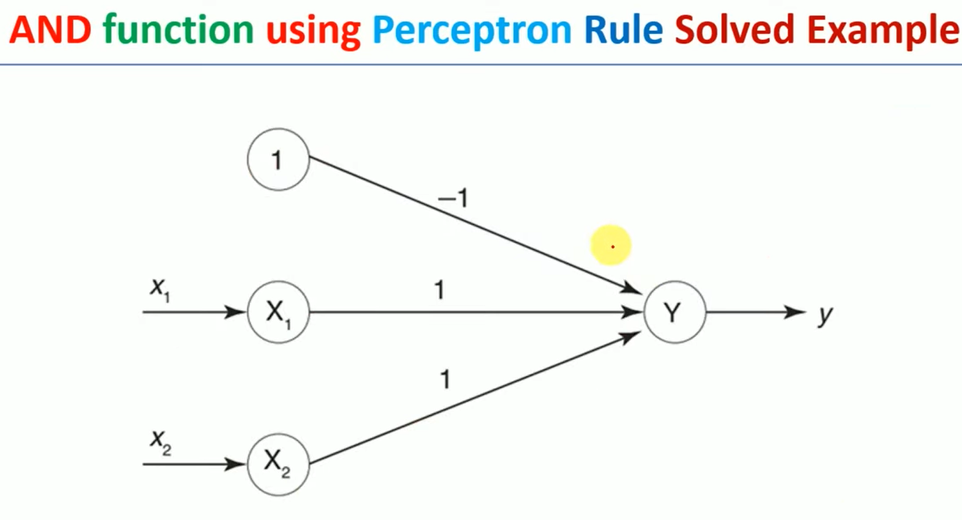

Slide 43
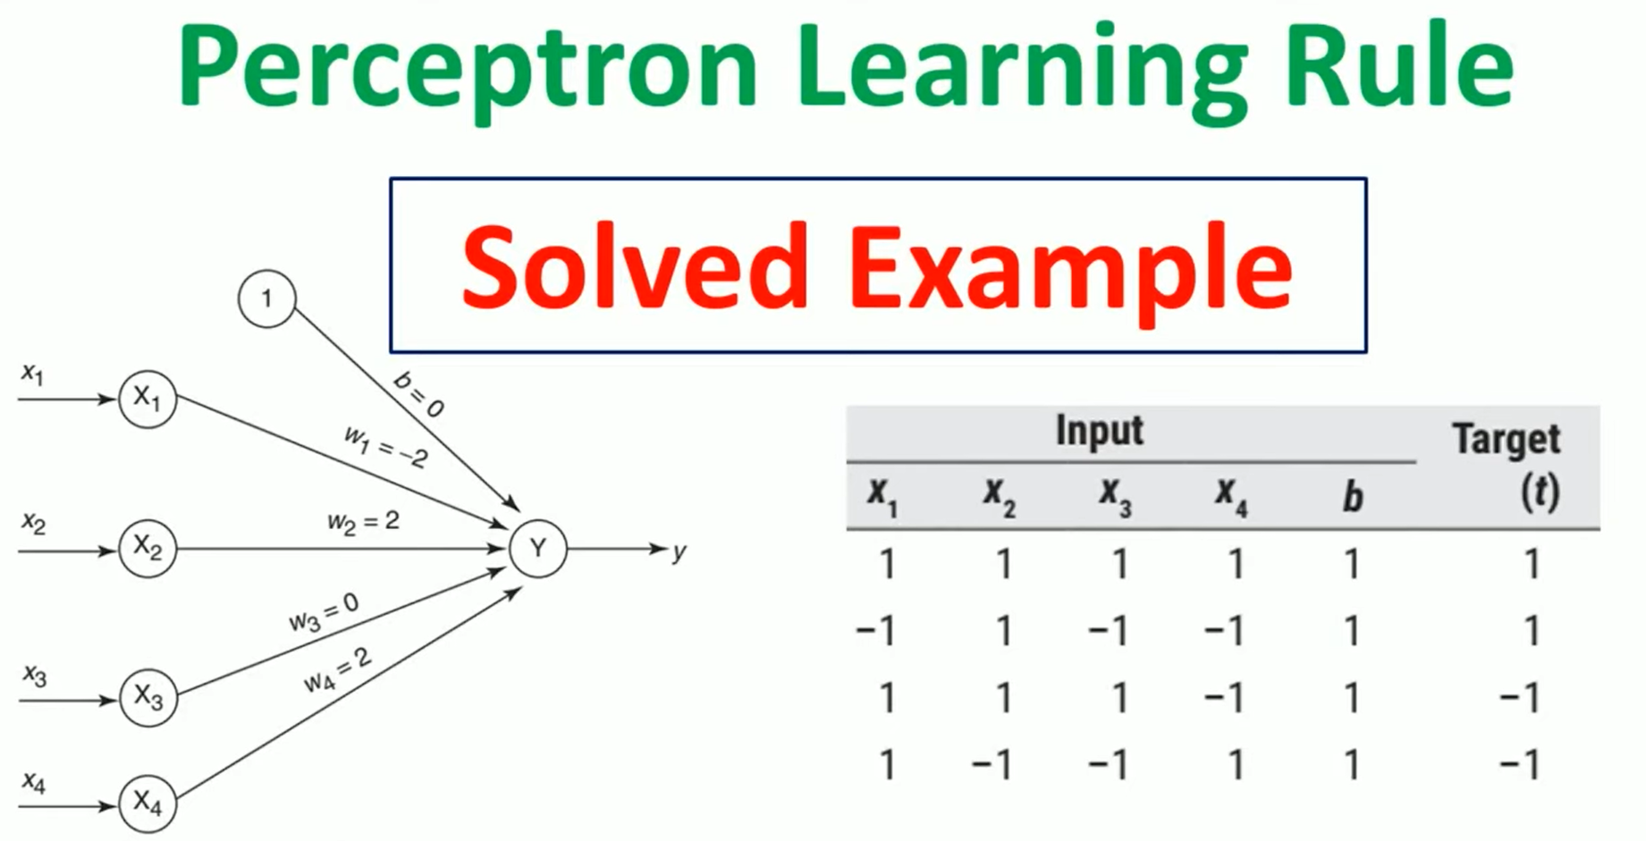

Slide 44
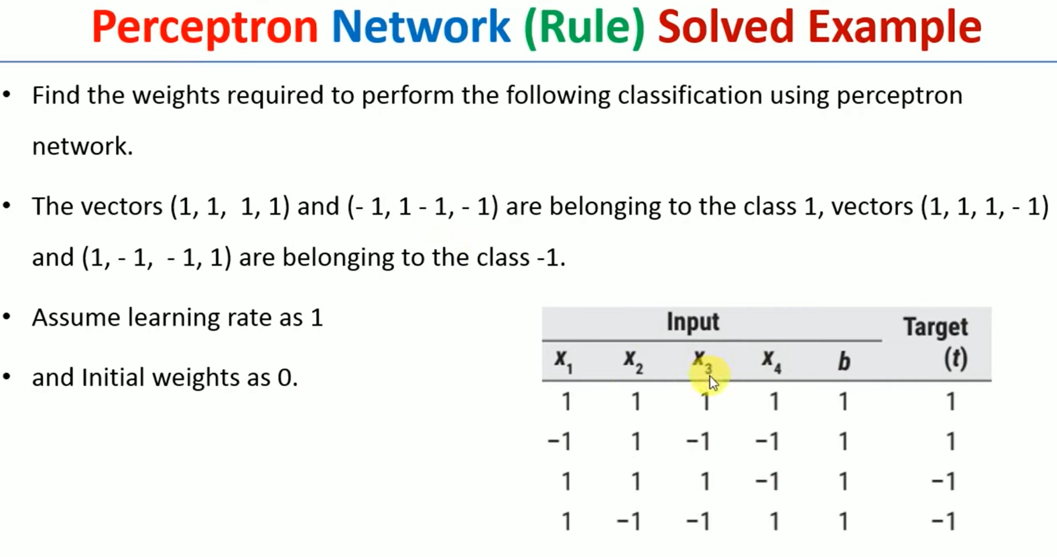

Slide 45
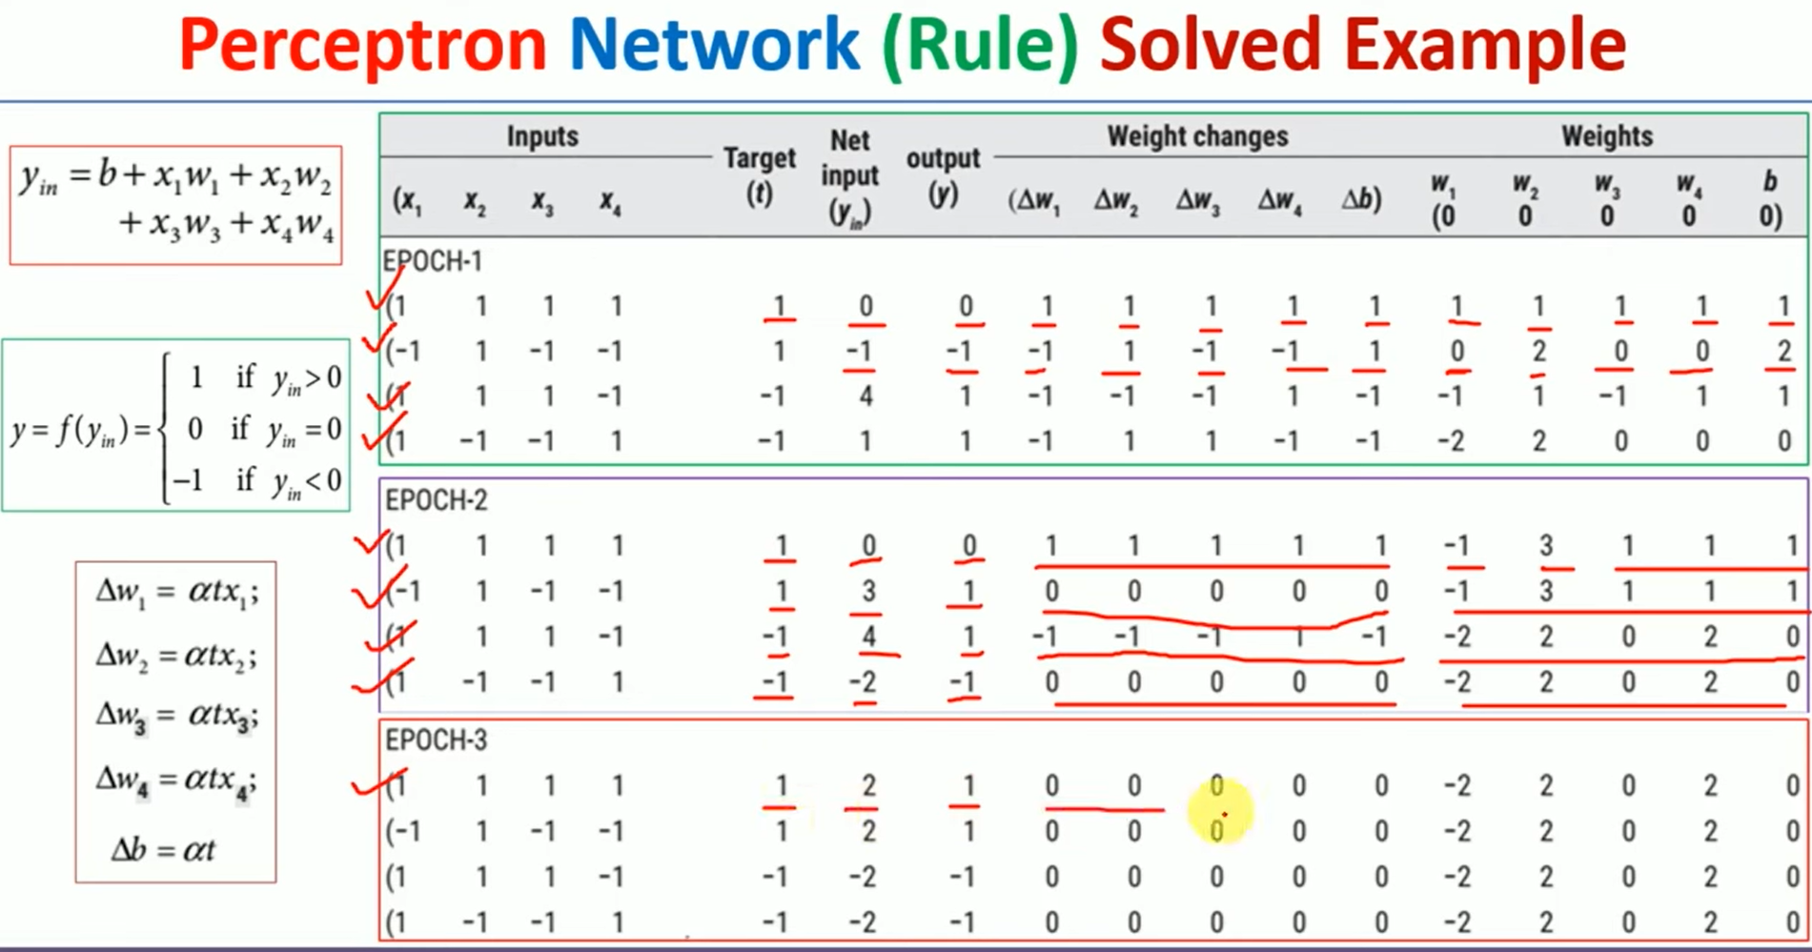

Slide 46
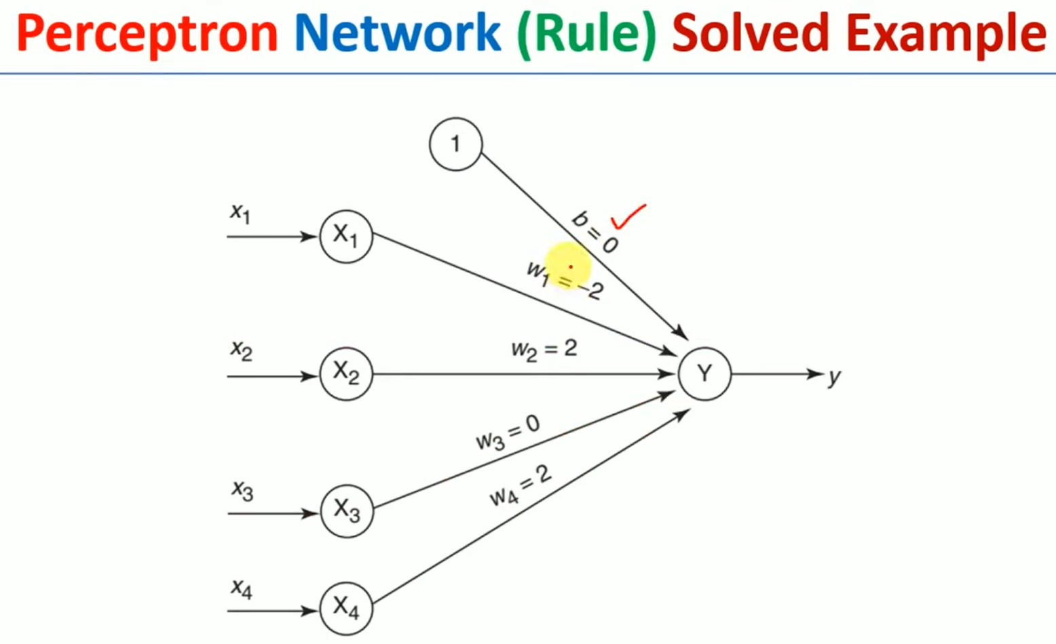

Slide 47
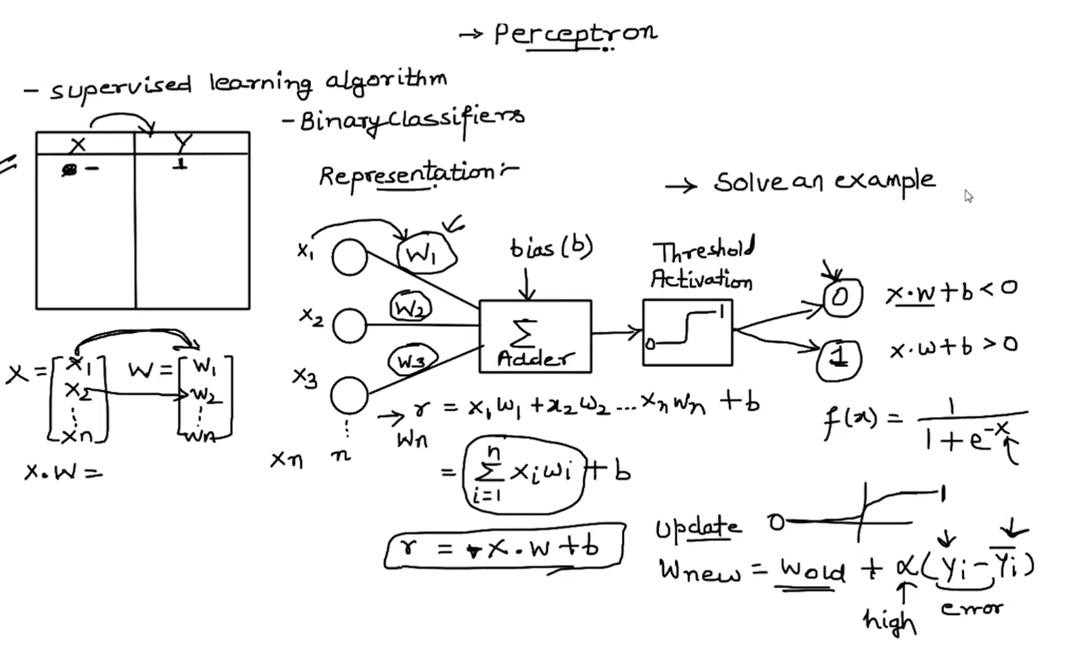

Slide 48
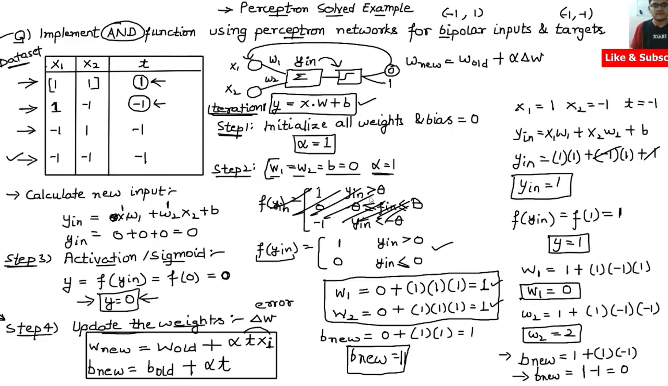

Slide 49
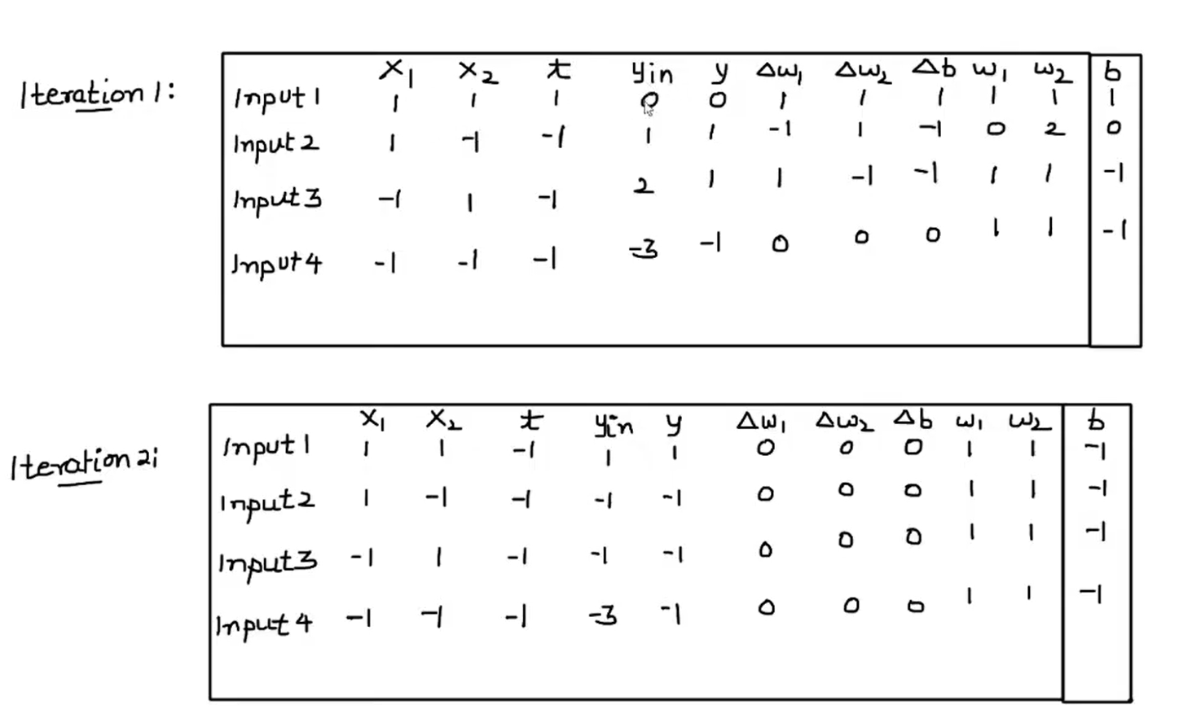

Slide 50
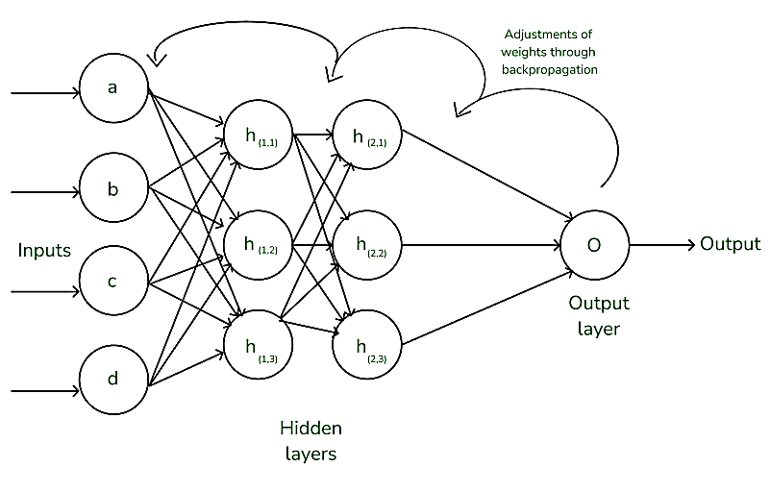
Backpropagation in Neural Network
Back Propagation is also known as "Backward Propagation of Errors" is a method used to train neural network . Its goal is to reduce the difference between the model’s predicted output and the actual output by adjusting the weights and biases in the network.
It works iteratively to adjust weights and bias to minimize the cost function. In each epoch the model adapts these parameters by reducing loss by following the error gradient. It often uses optimization algorithms like gradient descent or stochastic gradient descent. The algorithm computes the gradient using the chain rule from calculus allowing it to effectively navigate complex layers in the neural network to minimize the cost function.

Slide 51
Back Propagation plays a critical role in how neural networks improve over time. Here's why:
Efficient Weight Update: It computes the gradient of the loss function with respect to each weight using the chain rule making it possible to update weights efficiently.
Scalability: The Back Propagation algorithm scales well to networks with multiple layers and complex architectures making deep learning feasible.
Automated Learning: With Back Propagation the learning process becomes automated and the model can adjust itself to optimize its performance.

Slide 52
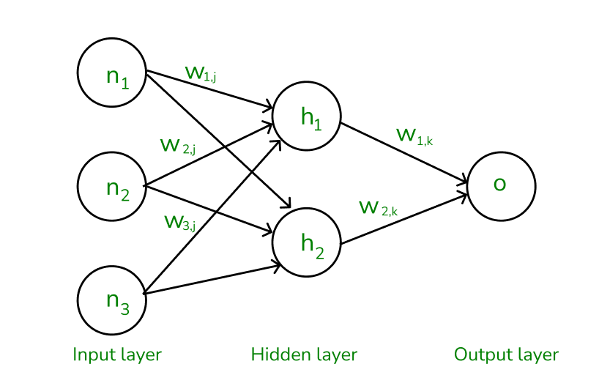
Working of Back Propagation Algorithm
The Back Propagation algorithm involves two main steps: the Forward Pass and the Backward Pass.
1. Forward Pass Work
In forward pass the input data is fed into the input layer. These inputs combined with their respective weights are passed to hidden layers. For example in a network with two hidden layers (h1 and h2) the output from h1 serves as the input to output. Before applying an activation function, a bias is added to the weighted inputs.
Each hidden layer computes the weighted sum (`a`) of the inputs then applies an activation function like ReLU (Rectified Linear Unit) to obtain the output (`o`). The output is passed to the next layer where an activation function such as softmax converts the weighted outputs into probabilities for classification.

Slide 53
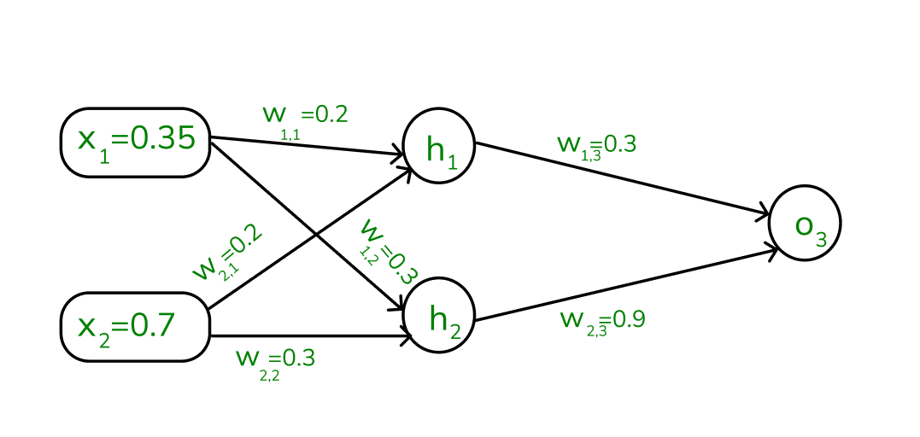
2. Backward Pass
In the backward pass the error (the difference between the predicted and actual output) is propagated back through the network to adjust the weights and biases. One common method for error calculation is the Mean Squared Error (MSE) given by:
MSE=(Predicted Output−Actual Output)2
Once the error is calculated the network adjusts weights using gradients which are computed with the chain rule. These gradients indicate how much each weight and bias should be adjusted to minimize the error in the next iteration. The backward pass continues layer by layer ensuring that the network learns and improves its performance. The activation function through its derivative plays a crucial role in computing these gradients during Back Propagation.
Example of Back Propagation in Machine Learning
Let’s walk through an example of Back Propagation in machine learning. Assume the neurons use the sigmoid activation function for the forward and backward pass. The target output is 0.5 and the learning rate is 1.

Slide 54
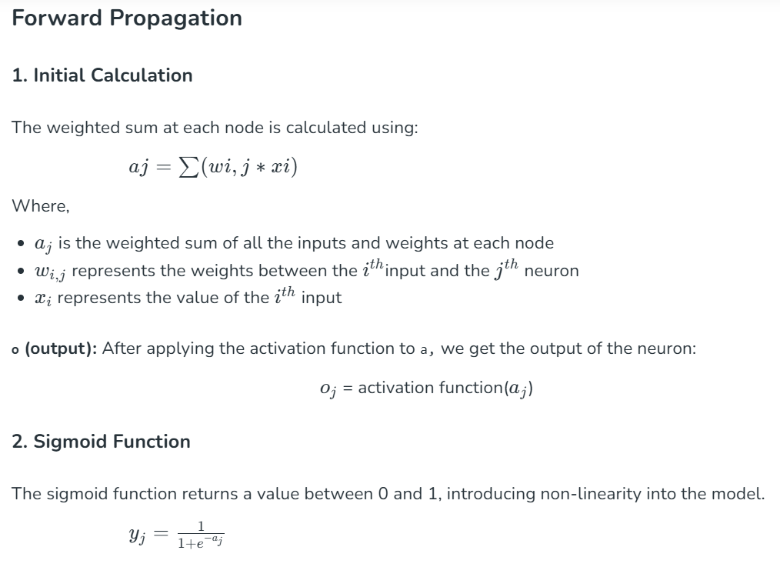

Slide 55
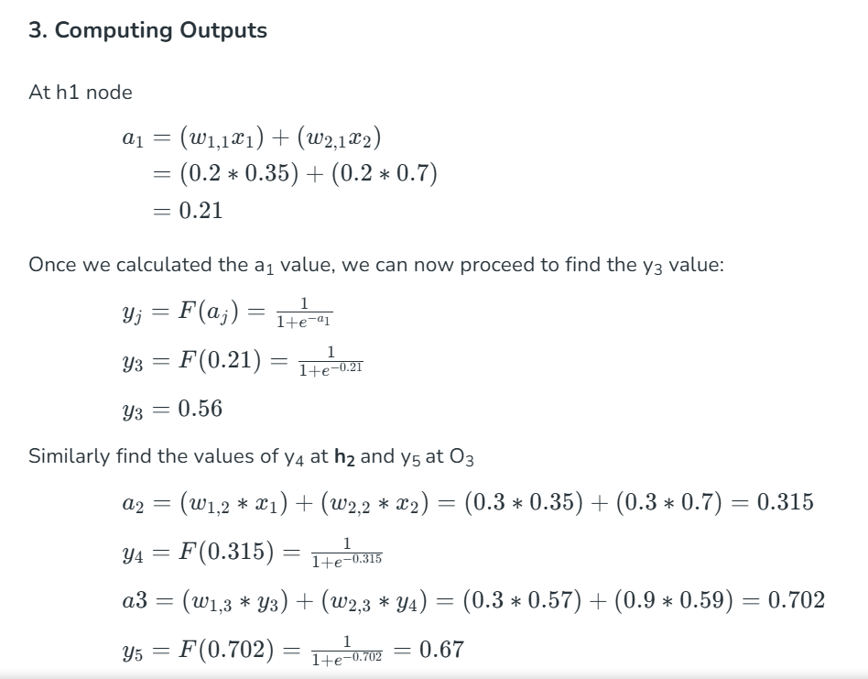
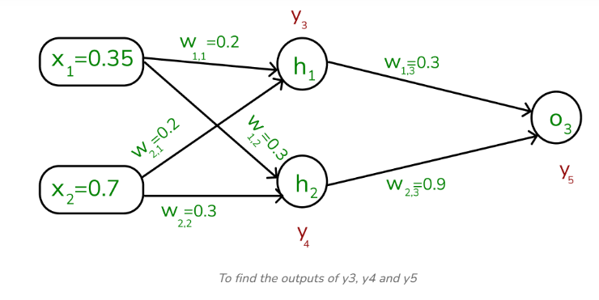
0.578
.6858

Slide 56
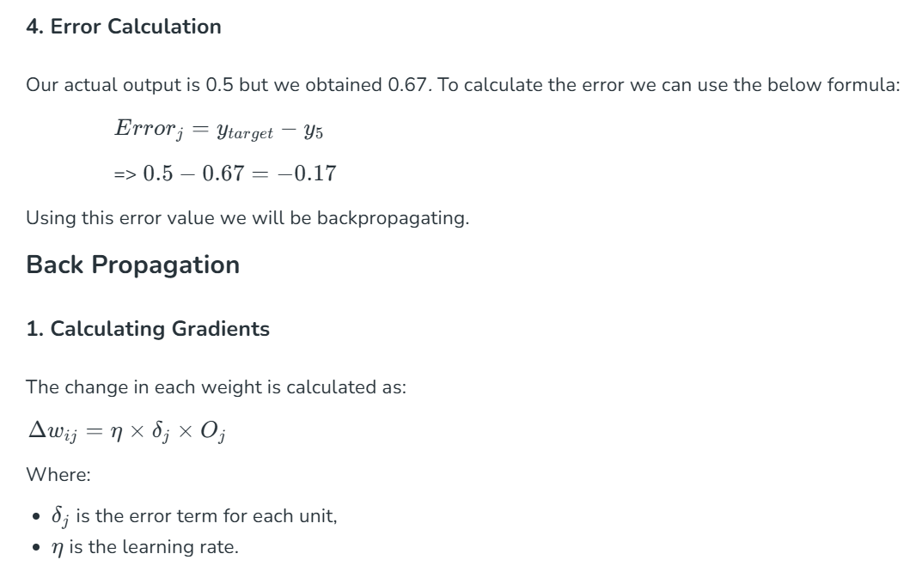
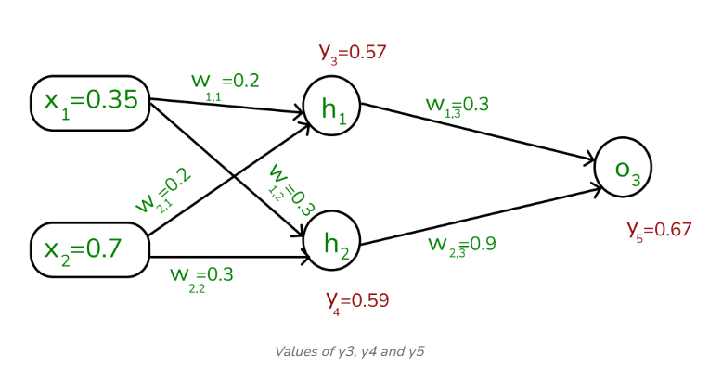

Slide 57
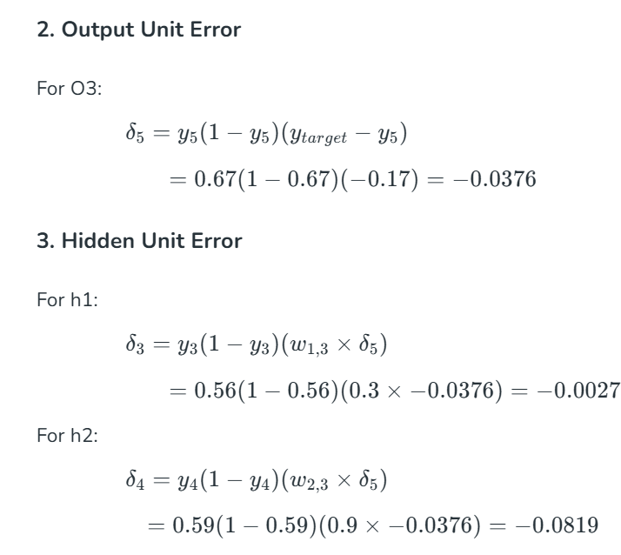
-0.00825

Slide 58
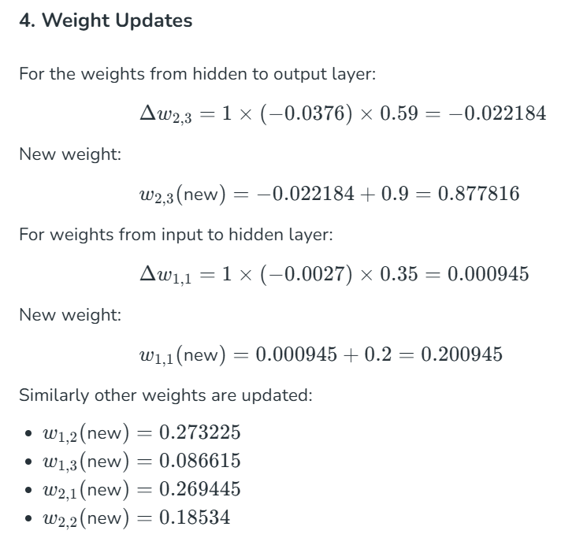
0.875
0.198
0.295
0.275
0.198
0.295

Slide 59
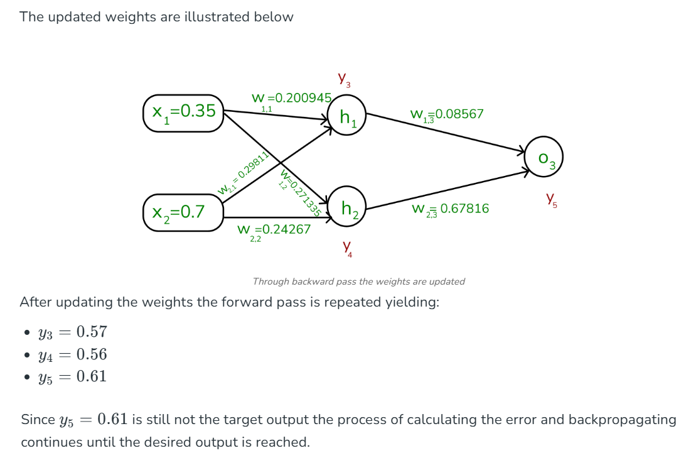

Slide 60
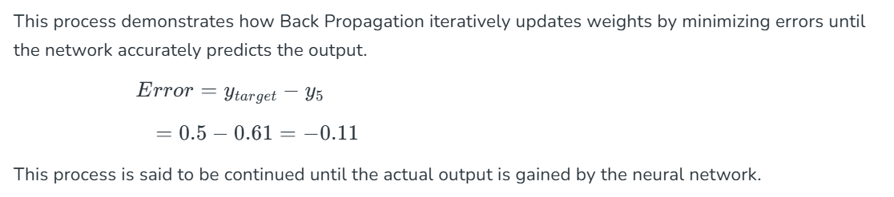

Slide 61
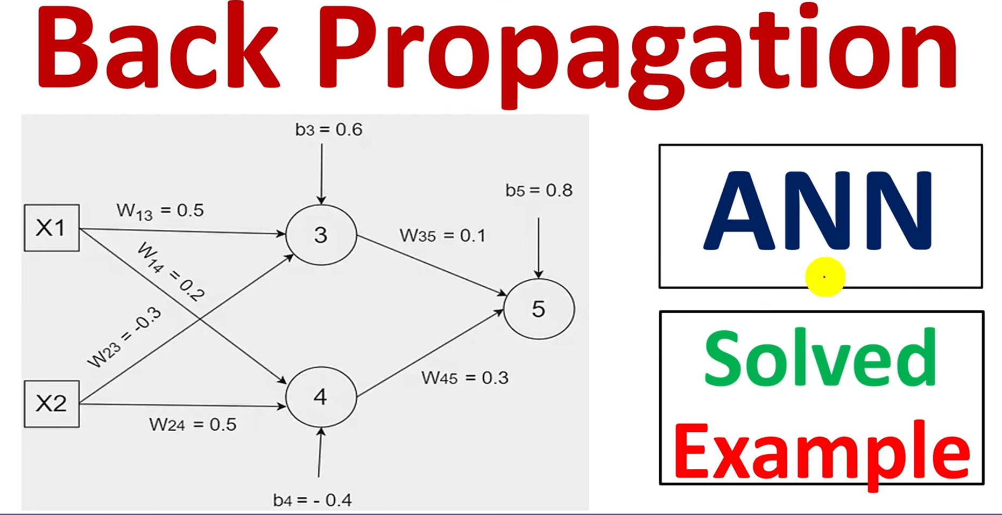

Slide 62
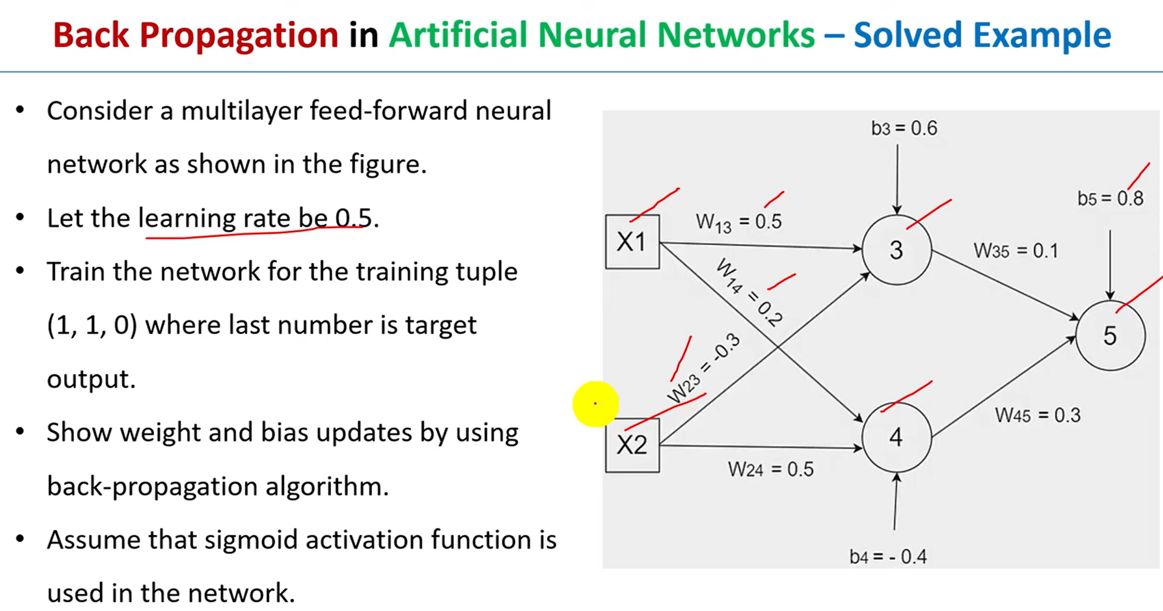

Slide 63
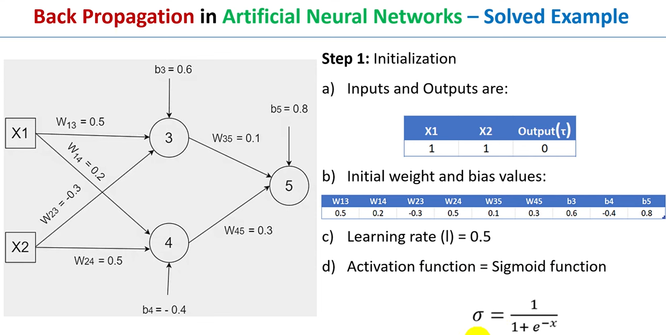

Slide 64


Slide 65


Slide 66


Slide 67


Slide 68


Slide 69


Slide 70


Slide 71


Slide 72


Slide 73


Slide 74


Slide 75


Slide 76


Slide 77


Slide 78


Slide 79
Example 02
https://www.youtube.com/watch?v=n2L1J5JYgUk

Slide 80


Slide 81


Slide 82


Slide 83


Slide 84


Slide 85


Slide 86


Slide 87


Slide 88


Slide 89
What is the difference between Perceptron and Multi-layer Perceptron?
The Perceptron is a single-layer neural network used for binary classification, learning linearly separable patterns. In contrast, a Multi-layer Perceptron (MLP) has multiple layers, enabling it to learn complex, non-linear relationships. MLPs have input, hidden, and output layers, allowing them to handle more intricate tasks compared to the simpler Perceptron.

Slide 90
How does the network learn?
The training samples are passed through the network and the output obtained from the network is compared with the actual output. This error is used to change the weights of the neurons such that the error decreases gradually. This is done using the Backpropagation algorithm, also called backprop. Iteratively passing batches of data through the network and updating the weights, so that the error is decreased, is known as Stochastic Gradient Descent ( SGD ). The amount by which the weights are changed is determined by a parameter called Learning rate.

Slide 91
Thank You

